Slide 1
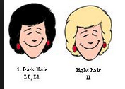
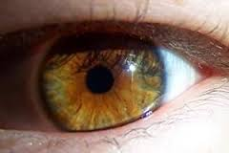
Compare and contrast the characteristics of learned behaviors and of inherited traits.
Inherited Traits
Cat's arched back when scared
Plants leaning towards light
Spiders spinning webs
Can roll your tongue
Attached earlobes
Long teeth
Have big feet
Shape of nose
Dog barking
Hair color
Long fur
Baby crying
Long fingers
Blushing
Hibernation
Speed
Eating plants
Eye Color
Widow's Peak
Height
Shape of a leaf

Slide 2
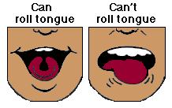
Roll Your Tongue
The ability to roll your tongue into a U-shape with the sides curled upwards is conferred by a dominant gene.

Slide 3
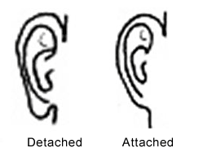
Earlobe Attachment
Inheritance of a dominant gene produces unattached or ‘free’ earlobes. There is considerable variation in the size and shape of the lobes which is due to the influence of other genes.

Slide 4
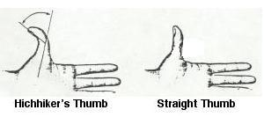
Hitch Hikers Thumb
The ability to bend either thumb backwards beyond 45 degrees reflects the absence of the dominant gene which prevents this ability. Also known as “distal hyper extensibility of the thumb.”

Slide 5
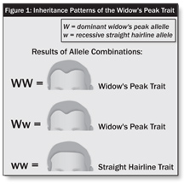
Widow’s Peak
A dominant gene causes the hairline to form a distinct downward point in the center of the forehead. Baldness will mask this trait.

Slide 6
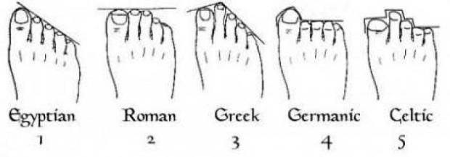
Hallux Length
The length of the big toe (hallux) is governed by the Ha gene. The big toe is longer than or equal to the second toe only in the homozygous recessive. A hallux shorter than this indicates the possession of a dominant Ha gene allele.

Slide 7
Facial Dimples
The inheritance of cheek dimples is controlled by a dominant gene D. The d/d genotype lacks the ability to express facial dimples

Slide 8
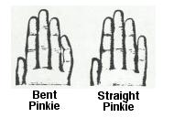
Bent Little Finger
A dominant gene causes the last joint of the little finger to bend inwards towards the fourth finger. Place hand on table and relax muscles to test.

Slide 9
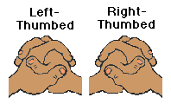
Interlocking Fingers
When the fingers are interlocked, some people will almost invariably place the left thumb on top ....and other people will place the right over the left. Studies have shown that the placing the left over the right is due to a dominant gene (F) while placing the right on top occurs only in the recessive (ff) genotype.

Slide 10
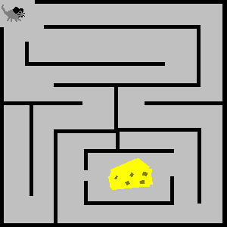
Learned Traits
Animals staying away from something after a bad encounter
Speaking more than one language
Speak the same language
Swimming in the pool
Brushing your teeth
Playing with friends
Riding a bike
Hunting
Reading
Favorite sport is basketball
Animals finding food from humans
Table Manners
Understanding a language

Slide 11
Flash cards inherited and learned traits
http://quizlet.com/22657458/5th-grade-sciencetraits-and-learned-behaviors-flash-cards/
What is a gene?
http://kidshealth.org/kid/talk/qa/what_is_gene.html
Vocabulary quiz
http://www.flashcardmachine.com/5th-grade-geneticsvocabularyquiz.html
Life science
http://www.internet4classrooms.com/grade_level_help/life_science_fifth_5th_grade_science.htm
Inventory of my genes teacher guide
http://www.usc.edu/org/cosee-west/AprilLectureMaterials/Activities/AnInventoryofMyTraits.pdf
Bunch of links
http://buncombe.k12.nc.us/Page/30134

